Slide 1
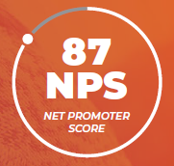
SmartConnect:
Simplifying Medicare

Slide 2
Agenda
Market Overview
About SmartConnect
Employee Experience
Medicare Assets for HR Members & Employees
Benefits GPS Tool
Virtual Presentations
Direct Marketing
Partner Reporting
SmartConnect & Your Organization
SmartConnect by the Numbers
Next Steps
Questions?
Notes:
Today we’re going to discuss how SmartConnect’s educational Medicare solution can benefit you and your employees.
Today’s Agenda Items Include:
A Medicare Market Overview
Who is SmartConnect & What do they do?
What your employees will experience when they work with SmartConnect
SmartConnect Resources for HR Members and Employees
The two SmartConnect subscription options
Potential Cost Savings
Finally we’ll review Next Steps and leave a few minutes for questions.

Slide 3
11,000 people turn 65 - every day - in the US.
For most, retiring at 65 isn’t a priority (and neither is enrolling in Medicare). Adults are working later in life than before — and addressing the health care needs of an aging workforce is a priority for organizations everywhere.
Fitting Medicare into your corporate benefits program doesn’t need to be complicated.
The people we help are the heart of our business. Our one-on-one, concierge approach ensures your employees’ needs always come first.
Demographic Trends
Notes:
11,000 people a day are turning 65 and for many of these- retirement is NOT top of mind. Most people are working long after 65 and for those who still have group coverage, Medicare is usually an afterthought.
SmartConnect empowers employees with the ability to access unbiased advice around Medicare, as we provide them with an unfiltered view of the market.
SmartConnect is here to make reviewing Medicare a stress free process allowing the employee, their family members and friends a trusted resource that they can count on to show them what they should or should not be doing.

Slide 4
About Us
What Do We Offer?
Who Do We Serve?
The Why?
Provide Medicare education and guidance via on-demand digital resources and phone consultations.
Evaluate Medicare as a lower-cost alternative
to group coverage.
Offer enrollment services for individuals choosing to enroll in Medicare coverage.
Medicare-eligible employees who are still working.
Employees transitioning or considering transitioning to retirement.
Employees assisting friends and family members with Medicare questions.
To ensure EVERY employee has an unbiased Medicare resource to find the most cost effective health insurance coverage available for the employee and their family members.
Notes:
Who is SmartConnect & What do they offer?
—--
SmartConnect is an exclusive Medicare Advocacy program created specifically for working and retiring adults (and family members and friends) who are Medicare-eligible.
They provide Medicare education and guidance to help individuals make a decision that’s best for their specific needs.
They’ll evaluate Medicare as a lower cost alternative to their group coverage and offer enrollment services if/when Medicare is determined to be a better option.
SmartConnect agents are licensed in all 50 states and are carrier neutral which means they can look at the entire marketplace from an unbiased perspective. Their consultative approach to Medicare ensures employees will not be pressured to make a decision.
It’s important to know that SmartConnect is an extension of your benefits and can be utilized by all employees, even if they’re not on the group plan. For example, if an employee’s spouse or family member needs Medicare assistance, SmartConnect can help!

Slide 5
The
SmartConnect
Experience
Connect: Help guide you and your family through the world of Medicare.
Educate: Ensure that you understand the details that impact enrollment, costs, and coverage.
Evaluate: Help you comparison shop across more than 20 leading carriers, to find the right plan for your needs.
Enroll: Our services are obligation-free, but if you decide to take action, we can enroll you on the spot.
Support: We have a dedicated team available to answer your questions, conduct policy reviews, and even help work with the carrier.
Notes:
Let’s take a look at the SmartConnect Experience and what your employees can expect when they connect with a SmartConnect agent.
SmartConnect always wants to use real numbers when making comparisons. They’ll ask that you provide a copy of your groups’ benefit guides in advance so their agents can reference them while speaking with employees. This allows them to have exact monthly contributions and OOP expenses to compare against when helping an employee consider Medicare vs. their group coverage.
Medicare has a wide range of benefits available and that’s what make it so confusing for most. SmartConnect will help your employees understand what they currently have in place, then help them compare those benefits to Medicare to ensure they have the most cost effective health insurance available that meets all of their needs AND MOST IMPORTANTLY, MAKE SURE THEY UNDERSTAND HOW IT WORKS.
When an individual calls in, the agent will first get to know them so they can customize their journey. The SmartConnect agent will ask questions about their health insurance needs and preferences.
They will educate the employee on the basics of Medicare and the style of coverage options that are available in their area.
The agent will provide a side-by-side comparison between the group health plan and the available Medicare options. They’ll assist the employee with identifying the best fit moving forward and review everything from Part A-Part D. The agent will help the individual determine if Medicare Supplement or Medicare Advantage is the best option for their specific needs and then they’ll review all the costs.
IF Medicare is determined to be the best option, the SmartConnect consultants will assist the employee with the enrollment process into the plan of their choice. In addition, each employee will be offered an annual policy review to ensure their plans adjust as their needs change over the years.
If for any reason Medicare isn’t the right fit whether it’s not cost effective or possibly the employee has dependents under their plan who don’t have any other insurance options, the SmartConnect agent will advise them that it’s best to stay on group coverage.

Slide 6
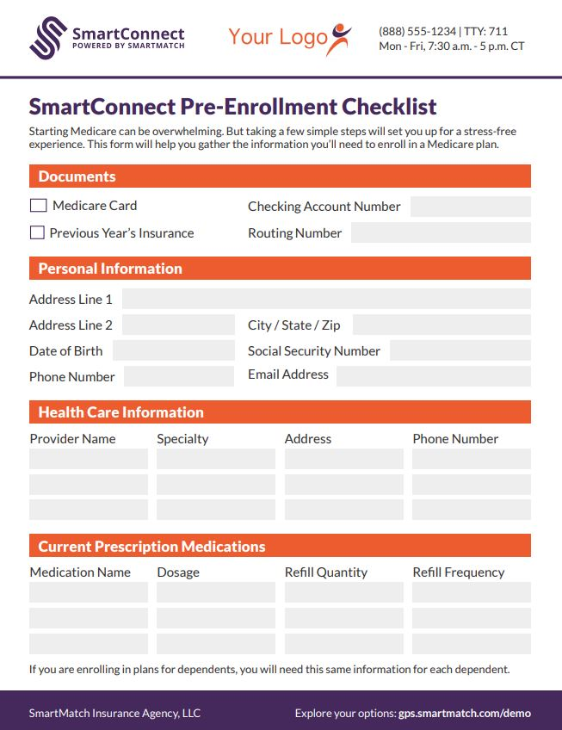
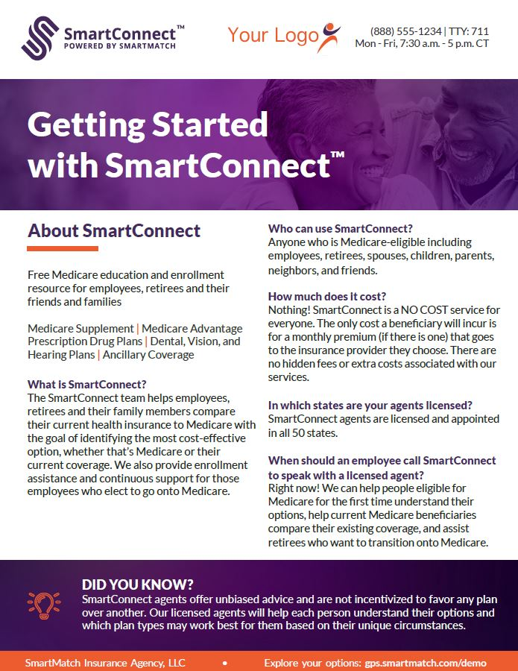
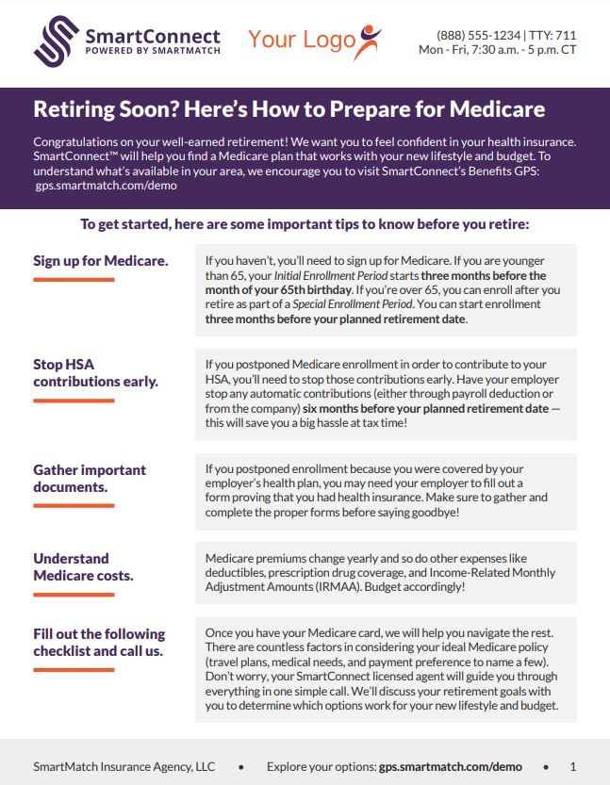
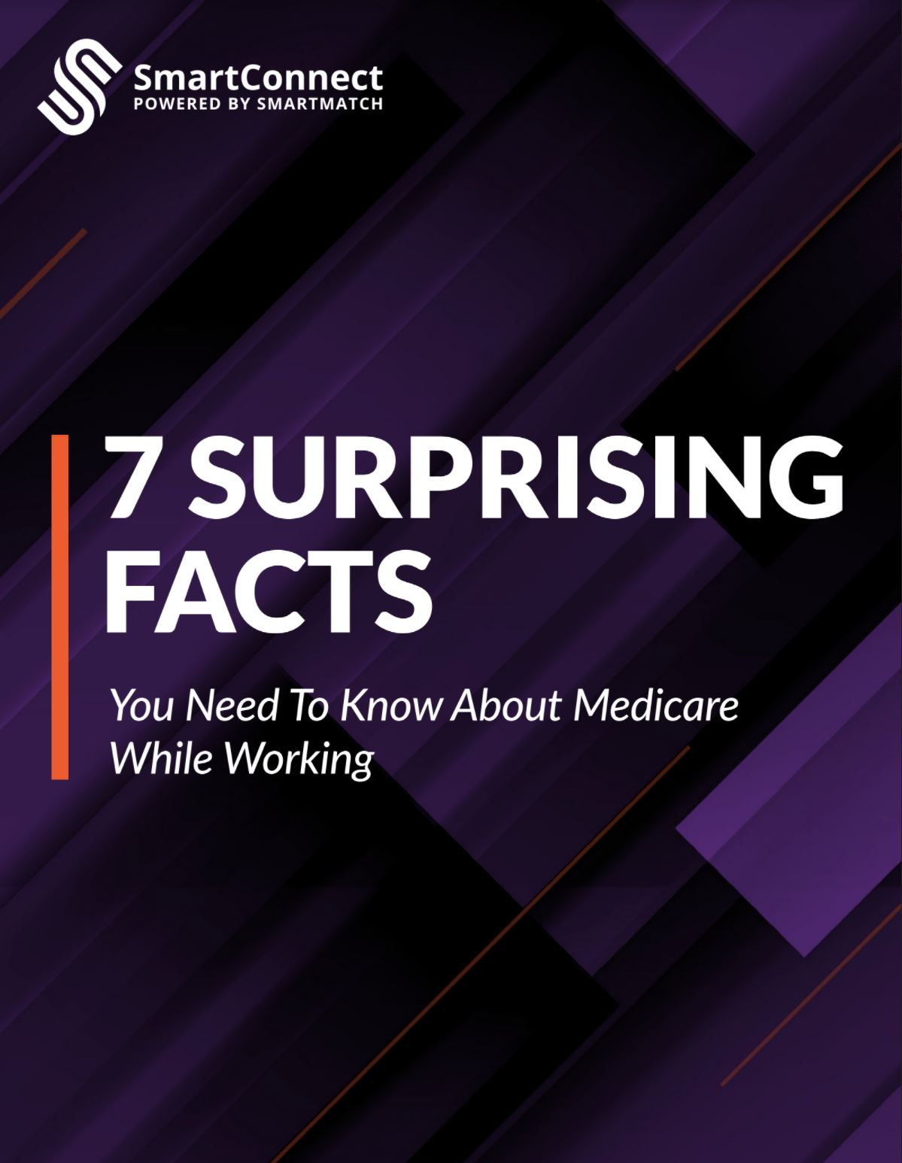
HR & Employee Assets
Notes:
SmartConnect provides a variety of resources to support HR teams to simplify the topics of Medicare. To name a few:
The Employee Engagement Templated Emails is a series of 6 email templates that are pivotal to drive awareness around the program. The most important template included is the Introducing SmartConnect email that HR should send out as soon as the program is live. This helps introduce employees to the partnership between SmartConnect and their organization. All the HR team has to do is simply copy, paste and hit send.
The Medicare Roadmap provides a high-level overview of the different styles of plans an employee is able to choose from when customizing their Medicare coverage.
SmartConnect for HR & Benefit Professionals to help Educate HR team on the services that SmartConnect offers and how we can assist the entire organization.

Slide 7
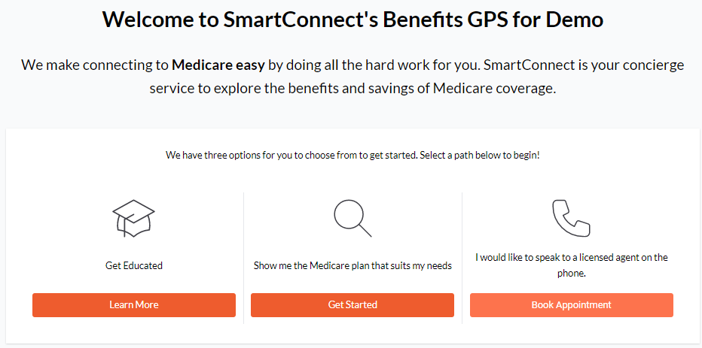
Benefits GPS Tool
One-stop shop for employees to access SmartConnect Medicare resources and connect with us!
Notes:
The Benefits GPS Website is a one-stop shop for employees to access all of the brochures we looked at in previous slides. The website is customized to include your organization’s logo and will also include your organization’s unique SmartConnect phone number. The educational guided shopping experience provides an opportunity for the individual to answer a series of questions to determine what style of secondary coverage might be the best fit for them.
In addition, the GPS includes a pre-recorded Medicare 101 Webinar that can be accessed at any time. This website is a great resources to include on your company’s intranet page or benefits guide.
DEMO SITE CAN BE ACCESSED HERE: https://gps.smartmatch.com/demo

Slide 8
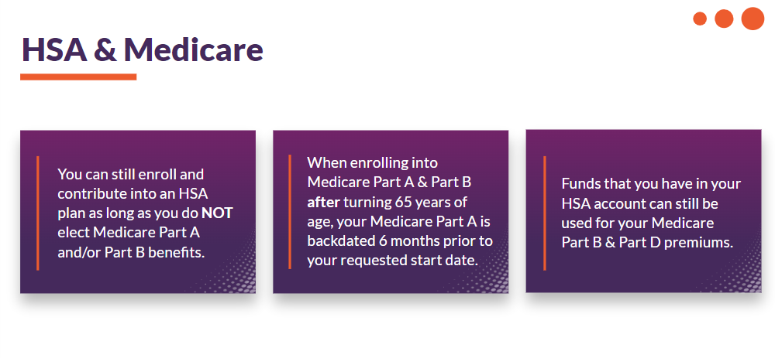
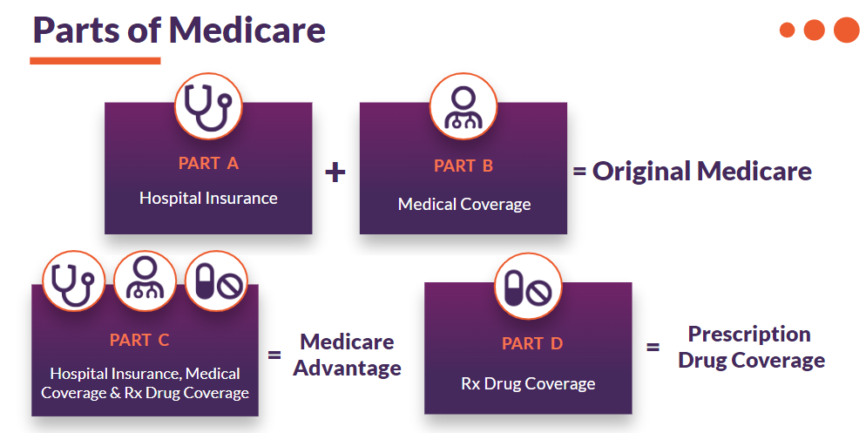
Virtual Presentations
Medicare 101 Webinars
Mini-Webinars: Topic of the Month
Quarterly Webinars for HR Members and Benefits Professionals
Benefit Fair Presentations
Notes:
SmartConnect offers a variety of Virtual Presentations tailored to employees and HR teams.
Their Medicare 101 Webinars are hosted monthly and aim to educate individuals on the most important Medicare topics and misconceptions. The monthly webinars are public to all SmartConnect clients; however, they offer private sessions for groups who want to them to host one specific to their employees.
Benefit Fair Presentations are great to schedule before or during your open enrollment and provide a short 10-15 minute presentation on what SmartConnect offers and how the employees can get in touch with them.
Finally, their Webinars for HR Members offer high-level Medicare education as well as tips on how to utilize all of the SmartConnect tools and further employee engagement.

Slide 9
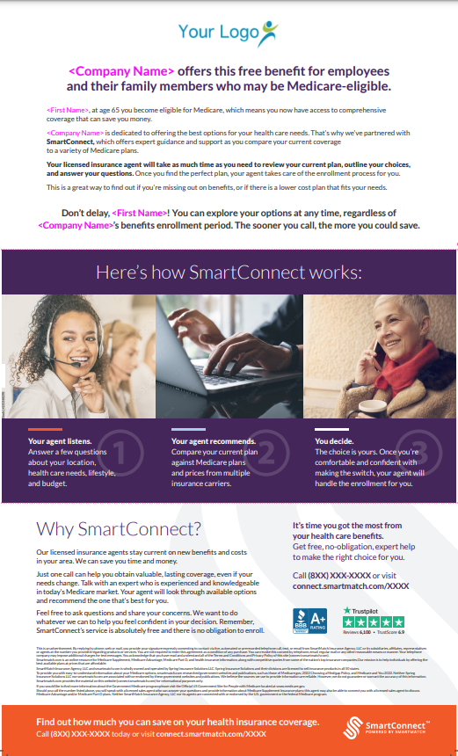
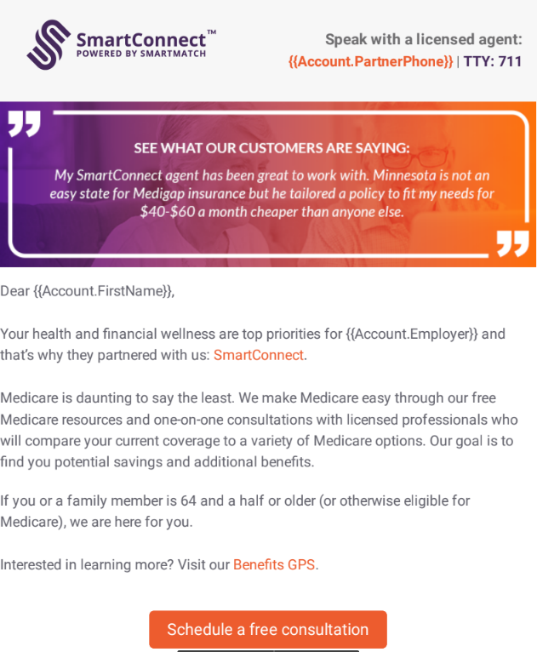
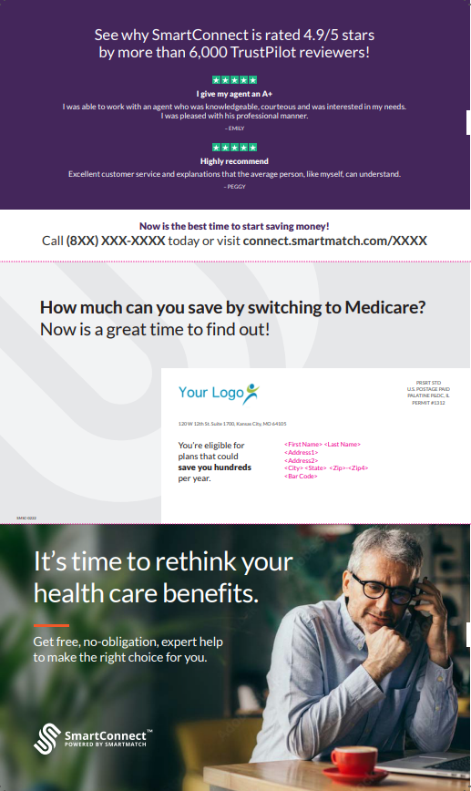
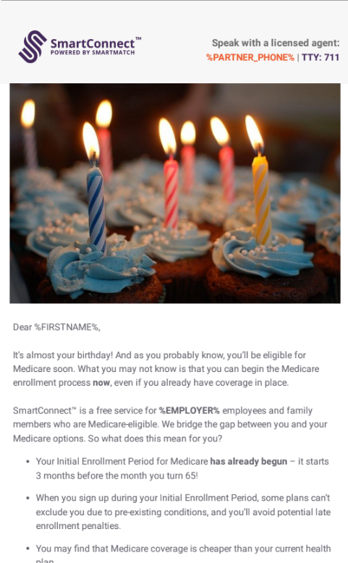
Direct Marketing: In-Home & Email Campaigns
Census Data Required, Uploaded via HR Portal
Monthly Educational Emails
In-Home Mailers
Welcome Emails & Mailers for Newly Eligible Individuals
Notes:
Direct Marketing has been proven to be the most effective way to get the word out about SmartConnect. Without the direct marketing, the HR team is responsible for sending all communications to their employees.
With the Active+ offering, your groups will receive direct mail in-home pieces by SmartConnect throughout the year. Marketing campaigns are also administered via email throughout the year. Employees will receive emails providing education on confusing medicare topics, registration links for upcoming webinars, and more! While it’s still critical that the HR teams send out the “Introducing SmartConnect” email template to their employees, the Active+ subscription takes work off their plate regarding correspondence so that their employees can keep SmartConnect top of mind.
Direct Marketing is proven to increase employee engagement by at least 50%.

Slide 10
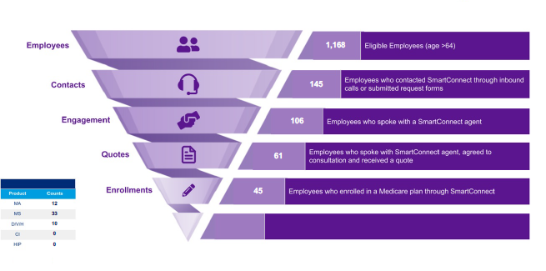
Partner Reporting
Year-End Utilization Reporting Including:
Total Number of Individuals who contacted SmartConnect
Total Number of Quotes
Total Number of Enrollments
Total Number of Employees who Transitioned to Medicare
Notes:
SmartConnect provides Year-End Utilization Reporting to each partner highlighting key stats such as the number of individuals who called in and how many enrolled into a Medicare plan.

Slide 11
SmartConnect and Your Organization
🗸 Reduces health care costs (for your
business and your people)
🗸 Adds value by expanding your
benefits Package
🗸 Delivers curated Medicare
resources
🗸 Frees you from having to
understand the complexities of
Medicare
Total Employee Population | Active Annual Fee | Active+ Annual Fee
0 - 500 Lives | $1,000 | $2,000
501 - 1,000 Lives | $2,500 | $5,000
1,001 - 5,000 Lives | $5,000 | $10,000
5,001 - 10,000 Lives | $7,500 | $15,000
10,001 - 20,000 Lives | $10,000 | $20,000
20,001 + Lives | $15,000 | $30,000
Notes:
Now that we’ve talked about both subscription options, let’s talk more about which option you think would work best for your organization and answer any questions you may have. Keep in mind the only difference between the two models is Direct Marketing. With Active+, groups will share census data and receive the in-home and email campaigns which helps take work off the HR team.

Slide 12
Real Savings from Valued Clients
Employer Industry:
Retailer, Outdoor Goods
Employer Industry:
Real Estate
Employer Industry:
Retail & Wholesale
Company Size: 33,000
Individuals Transitioned to Medicare:
26
Total Annual Employer Premium Savings: $192,108
Company Size: 7,500
Individuals Transitioned to Medicare:
19
Total Annual Employer Premium Savings:
$166,499
Company Size: 1,600
Individuals Transitioned to Medicare:
4
Total Annual Employer Premium Savings:
$26,649
*Savings are based on employer premium averages and do not account for claims
Notes:
Let’s talk a little bit about how the organization can save money while utilizing SmartConnect.
SmartConnect conducted a case study on five of their clients, each of varying size to help illustrate the financial impact SmartConnect has on the overall organization’s bottom line.
As you can see there were significant cost savings for all groups. A group as small as 1600 lives saved just under 27K in employer premiums alone. A group as large as 50K employees saved almost half a million dollars in one year. Keep in mind these figures are solely based on employer premiums and not employee claims.
All of these organizations are enrolled in the Active + subscription which provides direct marketing on their behalf to ensure employees get updates year-round. This takes a lot of the work off HR’s plate as they don’t have to do all of the communications.

Slide 13
Next Steps & Questions
Select your Subscription
Sign & Return Service Application
Complete Onboarding Profile
Receive Welcome Email from your SmartConnect Account Manager
Schedule a Solution Walkthrough for your HR team
Notes:
Let’s discuss next steps. After you select your desired subscription model you’ll sign and return the SmartConnect Service Application. From there, SmartConnect will send you additional information on how to complete the onboarding process. Upon completion of their onboarding profile, the SmartConnect team will get to work creating your co-branded resources and unique phone number. Once the resources have been finalized you’ll receive a Welcome Email from your SmartConnect Account Manager. The Welcome Email will provide instructions on how to get started with SmartConnect. Your dedicated Account Manager will invite you and your HR team to attend a Solution Walkthrough where they’ll help the team understand how to access our resources and, log into the portal and more.

Slide 14
What People are Saying
“I am so pleased that our company gave us the option to use SmartConnect. I have already had other employees asking me about my experience.”
“Easy to work with and no extra work for my HR Department. SmartConnect does it all for you!”
“I love that I have a resource that our employees who are nearing retirement can turn to.”
“Our agent was superb! We found her to be knowledgeable, patient and an absolute pleasure to work with. She is absolutely terrific.”
“I absolutely adore the employees at SmartConnect, and the company as a whole. Medicare is so frightening to most people and there are so many ‘untruths’ out there that I find employees are thrilled that we have a company that I trust.”
“Our agent was superb! We found her to be knowledgeable, patient and an absolute pleasure to work with. She is absolutely terrific.”

Slide 15
SmartConnect Partners

